Slide 1
Infectious Disease
Pathogens
Portal of entry & exit
Life cycle
Mode of transmission - recap
Virus
structure
Virus Replication

Slide 2
Infectious Disease
Syllabus:
The major groups of organisms that cause disease are bacteria, fungi, protists and viruses; each group can be distinguished by its structural characteristics
The life cycle of a pathogen and its associated diseases, including the method of invading the host, the impact on the host, and the mode of transmission (direct or indirect), determines its success for survival
Describe the structure of a virus
Describe the life cycle of a pathogen
Describe the different modes of transmission of pathogens
Biozone
74 Infection & Disease
75 Transmission of Disease
Biology WA UNITS 3 & 4
Reading
Chapter 12 – pages 407 – 413
Chapter 13 – pages 431 – 435
Question Sets
12.1a, 12.1b, 12.2, 13.1 and 13.2
Essential
Question:
Recap:
Define the term pathogen and state the four groups of pathogens can cause disease

Slide 3
Topic Question 1: Describe the main features of a pathogens life cycle
Infected host reservoir
Site for replication of infectious agent
Portal of exit
Some infectious diseases have another possible reservoir
Mode of transmission
Portal of entry
Susceptible host
Portals of entry | Portals of exit
Skin Mucous membranes Wounds in epidermal layers of animals and plants Eyes and ears Respiratory system/nose/throat/lungs | Bite/blood feed/saliva Digestion (elimination) Respiratory system (coughing, sneezing) Blood contact Reproductive system (some honeybee viruses pass from queen bee to worker bees)
Topic Question 2:
State the ways pathogens can leave a hosts body and how they can enter a susceptible hosts body

Slide 4
Recap: Describe the different ways diseases can be transmitted by direct transmission
Recap: Define the term transmission and the two modes of transmission
Transmission is how the pathogen is transferred from the host and/or a reservoir to a susceptible host, which can involve developmental stages occurring in the environment or in vectors.
Vectors are living or non-living things that transport pathogens from the infected host to a susceptible host. Mosquito vectors transport pathogens through blood feeds. Bat vectors transport pathogens through bites and scratches.
The different modes of transmission are commonly classified as direct or indirect. Direct transmission is the transfer of a pathogen from an infected host, or other reservoir, to a susceptible host by direct contact or droplet spread.
Indirect transmission is the transfer of a pathogen from a reservoir to a host through vectors (inanimate vehicles as well as living intermediaries) or suspended air particles.
Direct transmission
Direct contact
Transmission due to physical touch between an infected host and a susceptible host via skin/body fluids
ABL via infected bat
Influenza
Close contact
Transmission of pathogen in airborne droplets between an infected host and a susceptible host, such as sneezing/coughing within 1 metre or due to close proximity
Influenza
Reservoir (other)
Transmission from an inanimate reservoir/fomite to a susceptible host. A reservoir could be soil, as for tetanus bacteria.
Tetanus
Influenza (fomite)

Slide 5
Recap: Describe the different ways diseases can be transmitted by indirect transmission
Indirect transmission
Vector
A living thing that transmits a pathogen from an infected host to a susceptible host. Bats and mosquitoes are vectors.
Tetanus via dog-bite saliva
Honeybee viruses via varroa mite
ABL via healthy carrier bat
Ross River disease
Malaria
Indirect transmission
Soilborne/ waterborne/foodborne and vehicle or fomite
An inanimate object (fomite) acts as an intermediary between the portal of exit from the reservoir and the portal of entry to the host. For example, car tyres and human shoes can carry pathogens from a contaminated area to an area containing susceptible hosts.
Pathogens can swim or be carried through water or wet soil from an infected host to a susceptible host.
Contaminated food (note none of the diseases studies are transmitted this way)
Crown gall can enter via a wound
Chytridiomycosis
Phytophthora
Recap:
State the pathogens that cause the 10 diseases
Pathogen classification | Diseases
 | Influenza | Ross River disease/fever | Viral diseases of honeybees | Australian bat lyssavirus
 | Tuberculosis (TB) | Tetanus | Crown gall of plants
 | Chytridiomycosis (amphibian chytrid fungus disease) (caused by fungi)
 | Malaria | Phytophthora dieback (jarrah dieback)*

Slide 6
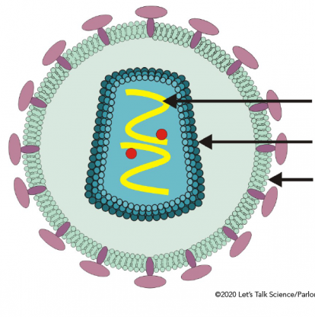
Topic Question 3:
Label the bacteriophage and the enveloped virus
Virus structural features
Topic Question 4:
List structural features of viruses

Slide 7
Topic Question 5:
Explain why a virus can be described as a non-cellular pathogen
Topic Question 6:
Describe why a pathogen can be said to be an obligate parasite

Slide 8
Topic Question 7:
Using a clearly labelled diagram describe how an enveloped virus replicates within a host eukaryotic cell

Slide 9
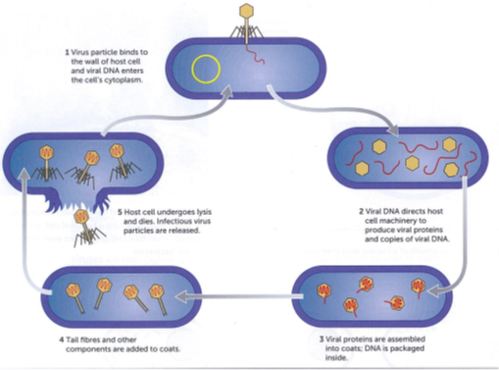
Use page 412 in your Biology WA ATAR Units 3 & 4 textbook to label and annotate the diagram below
Topic Question 8:
Using a clearly labelled diagram describe how a bacteriophage replicates within a host bacterial cell

